Slide 1




NEXT GEN EMPLOYABILITY PROGRAM
Creating a future-ready workforce
Team Members
College Name
Student Name : E YUVASHREE
Student ID : 513521104060
AMCET

Slide 2

CAPSTONE PROJECT SHOWCASE
Project Title
Building Bus Reservation System using Python and Django
Abstract | Problem Statement | Project Overview | Proposed Solution | Technology Used | Modelling & Results | Conclusion

Slide 3
Abstract
The bus reservation system is an essential component of modern transportation infrastructure, facilitating the efficient booking and management of bus tickets for passengers. In this project, we propose the development of a web-based bus reservation system using Python and the Django web framework. The system aims to provide a user-friendly interface for passengers to search for available bus routes, view schedules, and make online reservations.
The proposed system will consist of several modules, including user authentication, bus route management, ticket booking, and administration. Users will be able to register and login to their accounts, search for bus routes based on origin and destination, select preferred travel dates, and make reservations securely through the online platform. Administrators will have access to a dashboard to manage bus routes, schedules, ticket availability, and user accounts.

Slide 4
Problem Statement: Development of a Bus Reservation System using Python and Django
The bus transportation industry plays a crucial role in providing affordable and accessible travel options for commuters across various routes. However, traditional methods of bus ticket booking and management often involve manual processes, leading to inefficiencies, errors, and inconvenience for both passengers and bus operators. To address these challenges and modernize the bus reservation process, there is a need for a robust, user-friendly, and efficient bus reservation system.

Slide 5
Project Overview
User Authentication and Registration : Users can register for an account on the system by providing their details such as name, email, and password. They can then log in using their credentials to access the reservation features.
Bus Route Management : Administrators can manage bus routes by adding, editing, or deleting routes. Each route may include details such as origin, destination, departure time, arrival time, and fare.
Seat Availability and Booking : Users can search for available buses based on criteria such as origin, destination, and travel date. The system displays available buses along with their schedules and seat availability. Users can select a bus, choose their preferred seats, and proceed to book tickets.
Ticket Booking and Payment Processing : Once users have selected their seats, they can proceed to book tickets. The system calculates the total fare based on the number of seats selected and any applicable discounts. Users can then make payments securely using various payment methods such as credit/debit cards, net banking, or digital wallets.

Slide 6
Proposed Solution
.
1.User Authentication and Registration :
Implement a user authentication system using Django's built-in authentication framework .
Provide user registration functionality for new passengers to create accounts.
2.Bus Route Management :
Create a database model for storing bus routes, including origin, destination, departure time, and arrival time .
Implement CRUD (Create, Read, Update, Delete) functionality for bus routes through an admin interface .

Slide 7
3.Ticket Booking :
Develop a user-friendly interface for passengers to search for available bus routes based on origin, destination, and travel date .
Display a list of available routes with relevant details such as departure time, arrival time, and ticket price .
Allow passengers to select preferred routes, specify the number of seats, and proceed to the booking process .
Implement a secure payment gateway integration for processing online payments
4.Seat Reservation :
Implement seat reservation functionality to allow passengers to select specific seats based on availability .
Display seat layout diagrams for each bus route, highlighting available and reserved seats .
Ensure that seat selection and reservation are synchronized with the backend database to prevent double booking.

Slide 8
5.Responsive Web Design :
Ensure that the bus reservation system is accessible and responsive across various devices, including desktops, tablets, and smartphones.
Implement responsive design principles to optimize user experience and usability on different screen sizes.
6. Security and Data Privacy:
Implement security measures such as HTTPS encryption, CSRF protection, and input validation to safeguard user data and prevent security vulnerabilities.
Adhere to data privacy regulations such as GDPR (General Data Protection Regulation) to protect passengers’ personal information.
7. Testing and Quality Assurance:
Conduct thorough testing of the bus reservation system to identify and address any bugs, errors, or usability issues.
Perform functional testing, integration testing, and user acceptance testing to ensure the system meets the specified requirements and user expectations.
Source : chatgpt

Slide 9


Technology Used
Front-end
Back-end
Source :

Slide 10
Modelling & Results
To model and implement a bus reservation system using Python and Django, you would typically follow these steps:
Define Requirements: Determine the requirements and functionalities of the bus reservation system, including user authentication, bus route management, ticket booking, and administration features.
Design Database Schema: Design the database schema to store information such as users, bus routes
schedules, reservations, and transactions. Use Django's ORM to define models representing these entities.
Implement Views and Templates: Create Django views to handle user requests and render HTML templates to display the user interface. Use Django's built-in template system to generate dynamic content.
Develop Business Logic: Write Python code to implement the business logic of the bus reservation system, such as searching for available bus routes, validating user input, processing reservations, and managing bus schedules.
Source :

Slide 11
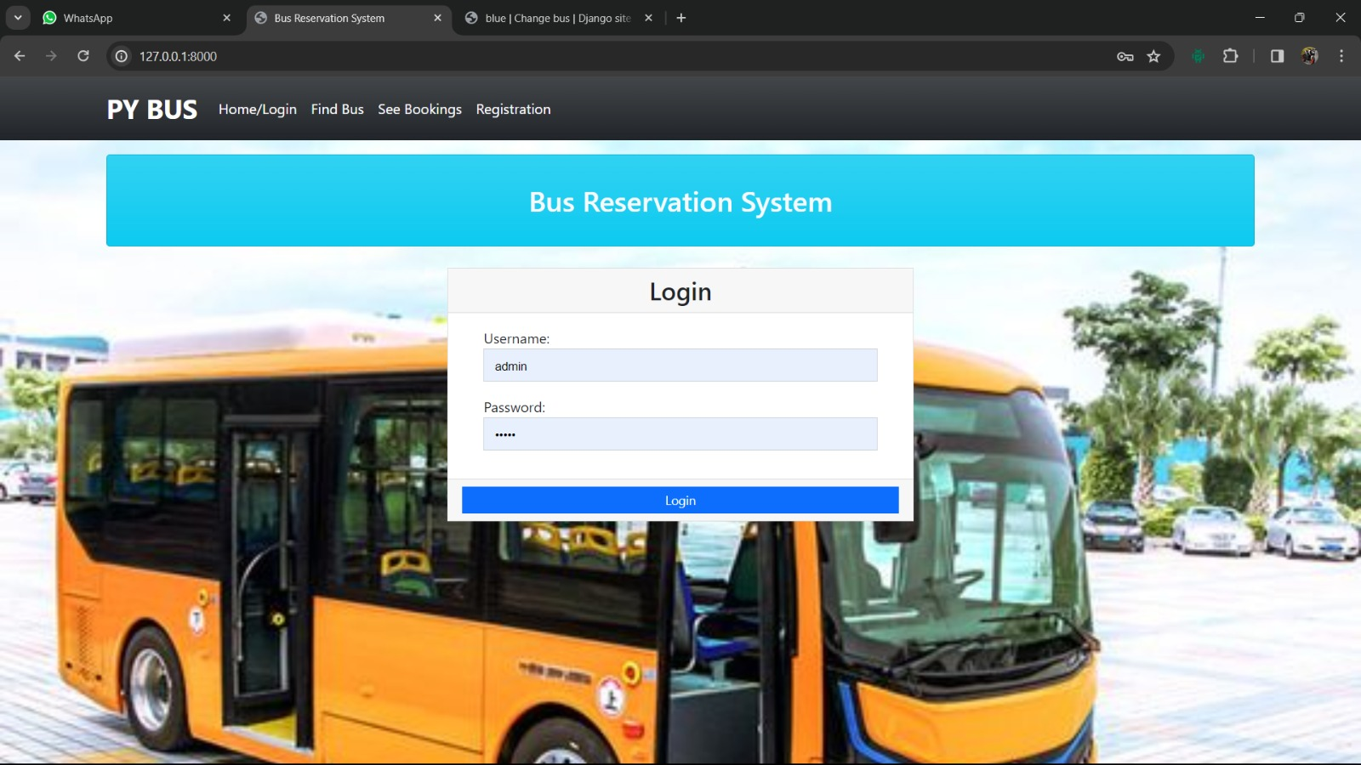
Homepage

Slide 12
About-Us-Page
Welcome to our bus reservation service, your one-stop solution for booking bus tickets conveniently and securely. At our bus reservation page, we strive to provide passengers with a seamless and hassle-free booking experience, allowing you to travel comfortably to your destination of choice.
Our Mission:
Our mission is to simplify the process of booking bus tickets by offering an intuitive online platform that connects passengers with bus operators seamlessly. We aim to revolutionize the way people travel by providing a convenient and efficient reservation service that saves time and enhances the overall travel experience
Contact Us:
Have questions or need assistance? Our customer support team is here to help. Feel free to reach out to us via email, phone, or live chat, and we'll be happy to assist you with any inquiries or concerns you may have.

Slide 13
Service-Page
Search for Routes:
Enter your origin and destination cities, along with your preferred travel dates, to search for available bus routes
View Schedules:
Browse through the list of available bus routes and schedules. View departure times, arrival times, and ticket prices for each route.Make a Reservation: Select your desired route and schedule, choose the number of tickets you need, and proceed to the booking page. Provide passenger details and payment information to confirm your reservation
Receive Confirmation:
Once your reservation is confirmed, you'll receive a booking confirmation email with your ticket details and itinerary.

Slide 14
Departments-Page
Create a Django App:
If you haven't already, create a Django app for managing the department page. You can do this by running the following command in your Django project directory
python manage.py startapp
Define URLs:
Define URLs for the department page in the urls.py file of your Django app.
Create Templates:
Create HTML templates for rendering the department page. You can create templates for displaying information about the department (home.html). Place these templates in the templates/department/ directory of your Django app.
Create Views:
Create views to handle the logic for displaying information about the different departments involved in managing the bus reservation system. You can define these views in the views.py file of your Django app
Include URLs:
Include the URLs of your department app in the main urls.py file of your Django project.Run the Development Server: Finally, run the Django development server to see your department page in action.

Slide 15
Blog-Page
Create a Django App for the Blog:
Start by creating a new Django app specifically for managing the blog functionality. You can do this by running the following command in your Django project directory
python manage.py startapp
Create Views: Create views to handle the logic for displaying the blog homepage and individual blog posts. You can define these views in the views.py file of your blog app
Create Templates: Create HTML templates for rendering the blog pages. You can create templates for the blog homepage (home.html) and individual blog posts (post_detail.html). Place these templates in the templates/blog/ directory of your Django project
Include URLs: Include the URLs of your blog app in the main urls.py file of your Django project.

Slide 16
Future Enhancements:
Real-Time Seat Availability: Implement a feature to display real-time seat availability for each bus route. This can help users make informed decisions when booking tickets and reduce the likelihood of overbooking.
Integration with GPS Tracking: Integrate GPS tracking technology to provide real-time tracking of buses on the map. This can allow passengers to track the location of their bus in real-time and estimate arrival times more accurately.
Mobile App Development: Develop a mobile app for the bus reservation system to provide users with a more convenient booking experience on their smartphones. The app can offer features such as push notifications, offline booking capabilities, and mobile payment options.
Dynamic Pricing: Implement dynamic pricing based on factors such as demand, time of booking, and seat availability. This can help optimize revenue and incentivize early booking
Route Optimization: Use data analytics and optimization algorithms to optimize bus routes, schedules, and capacity utilization. This can help minimize travel time, reduce fuel consumption, and improve overall efficiency.

Slide 17
Conclusion
In conclusion, the development of a bus reservation system using Python and Django offers a comprehensive solution to streamline the booking process, enhance user experience, and improve operational efficiency in the transportation industry. Through the implementation of various features such as user authentication, bus route management, real-time seat availability, and secure online payment processing, the system provides passengers with a user-friendly platform to search for routes, view schedules, and make reservations conveniently from any deviceFurthermore, the integration of advanced functionalities such as GPS tracking, dynamic pricing, and mobile app development presents opportunities for future enhancements to further enhance the system's capabilities and meet the evolving needs of passengers and service providers. By leveraging the power of Python and Django, the bus reservation system delivers a robust, scalable, and customizable solution that can adapt to the changing demands of the transportation market.Overall, the bus reservation system represents a significant advancement in modern transportation infrastructure, offering a digital platform to optimize route planning, increase passenger satisfaction, and drive operational efficiency for bus operators. Through continuous innovation and customer-centric design, the system aims to revolutionize the way people travel by bus, making it easier, more accessible, and more convenient for passengers to book their journeys and reach their destinations safely and efficiently.

Slide 18
Thank You!
Notes:
Thank You !!

